Slide 1
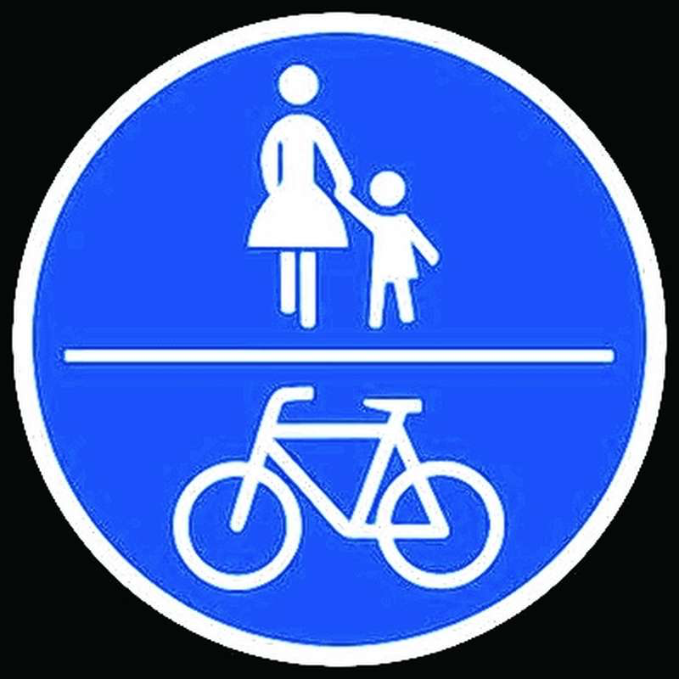
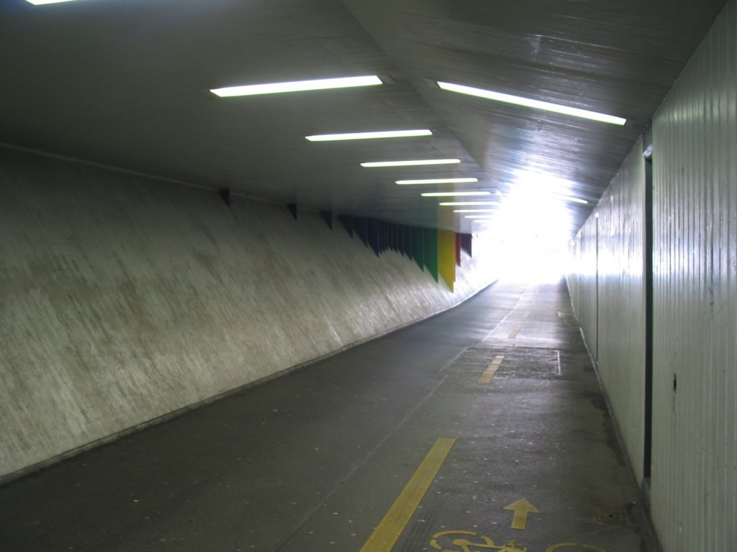
Modelling the interaction of pedestrians and bikers
We love cycling
Every day experience
Social Force Model
Capacity and Security
Bicycle bell
Bikeswarms
Sandro Giacomuzzi - Hannes Heller – Manuel Holzer

Slide 2
Reasearch Questions
Social Force Model for simulating bikers?
Effects of traffic separation by road marking?
Capacity
Security
Notes:
Is social force adequate?

Slide 3
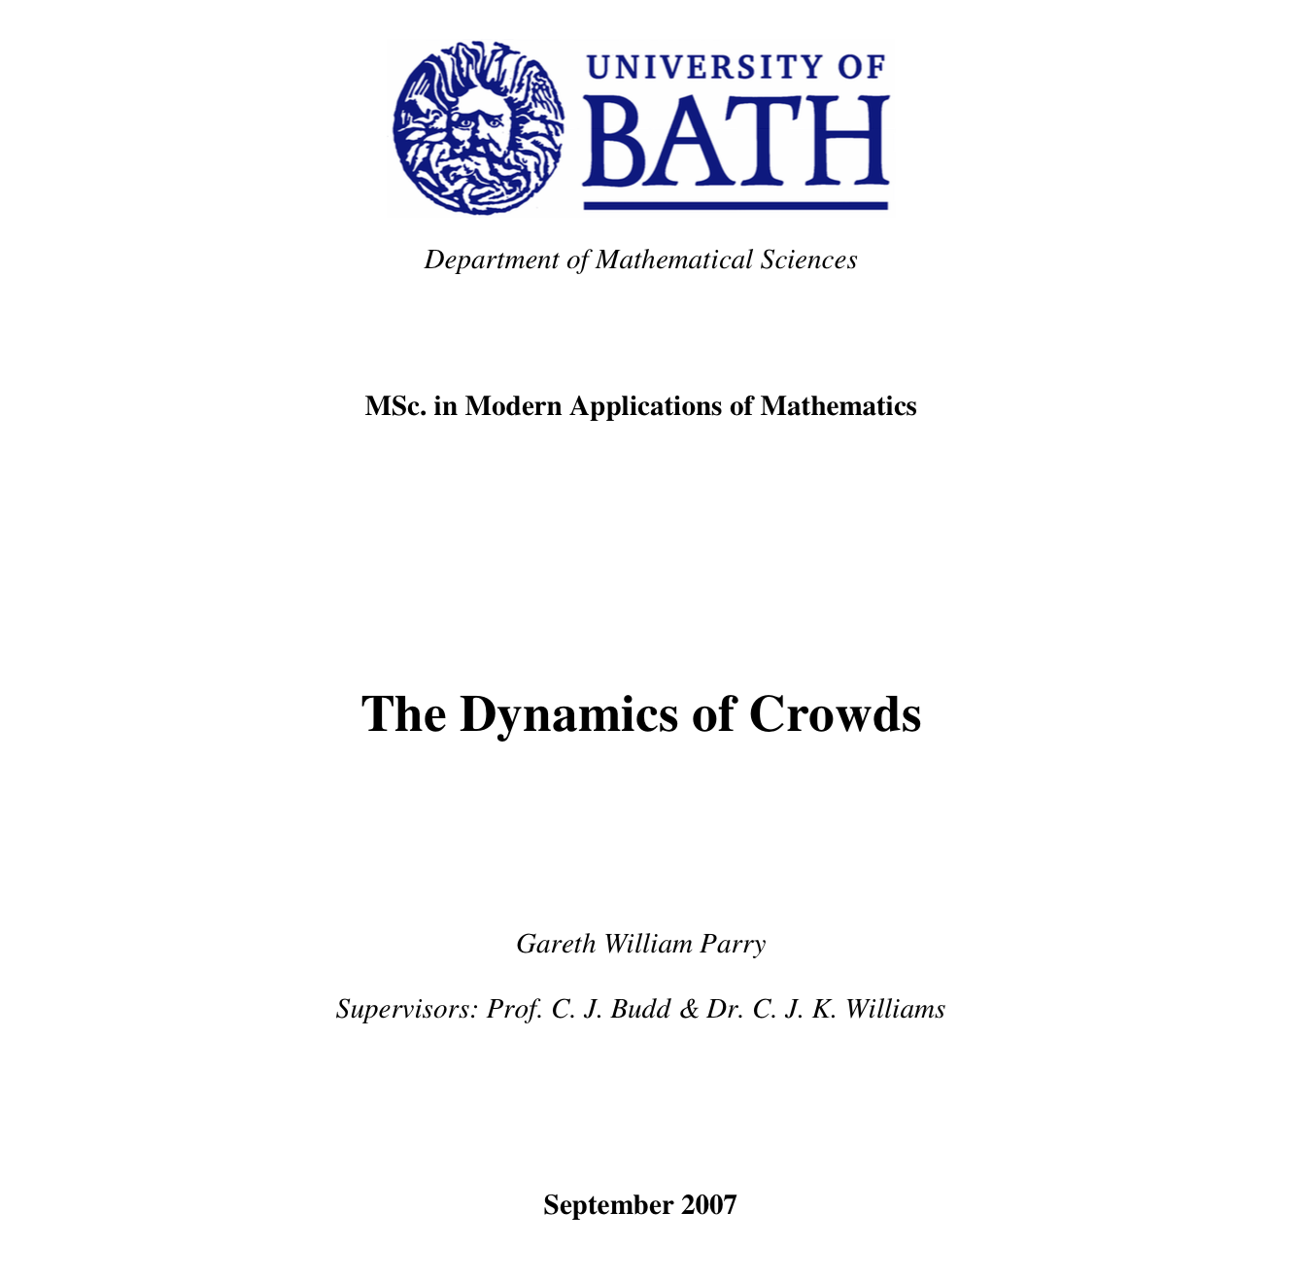

Slide 4

Notes:
What‘s the problem?

Slide 5
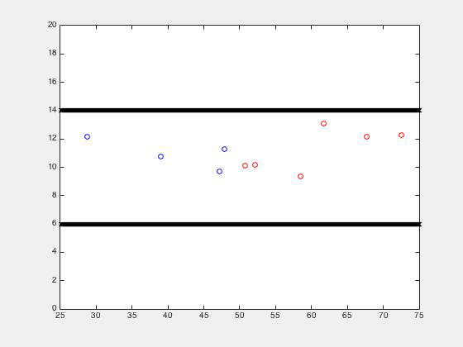
Notes:
Nicer colors

Slide 6
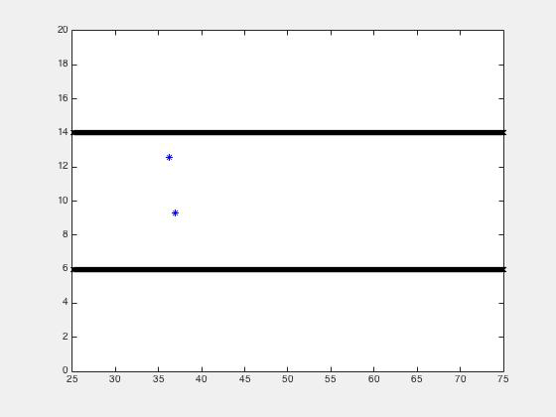

Slide 7
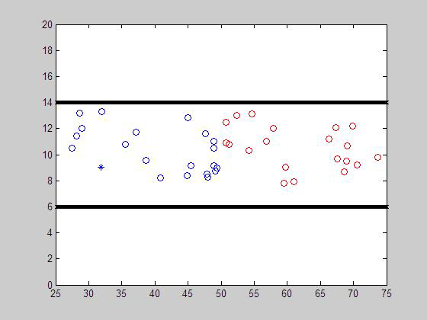

Slide 8
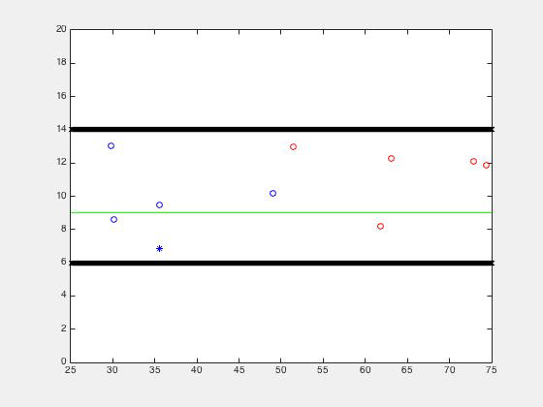

Slide 9
The social force model
Destination
3
2
1

Slide 10
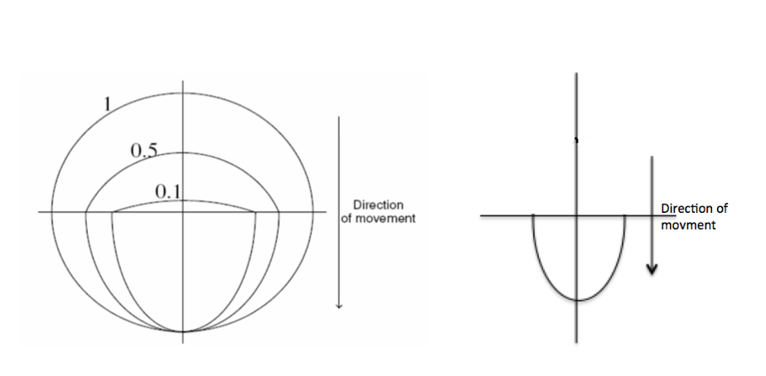
Modelling of bikers
Notes:
Radius of ellipse variable with speed!

Slide 11
Bike lane interaction

Slide 12
Bike lane interaction

Slide 13
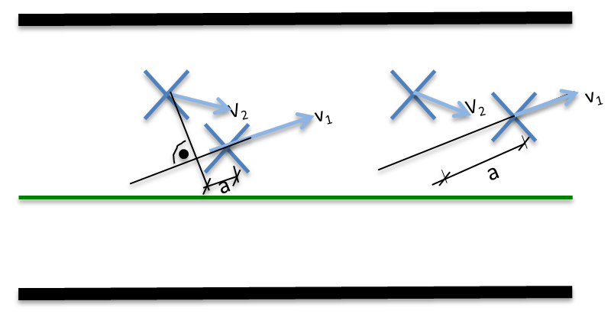
Slipstream
Biker only

Slide 14
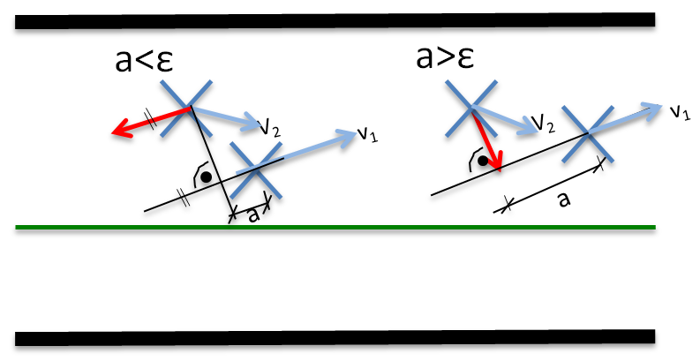
Slipstream
Biker only

Slide 15
Avoidance force
Pedestrians only
a

Slide 16
Avoidance force
Pedestrians only
a<ε
a

Slide 17
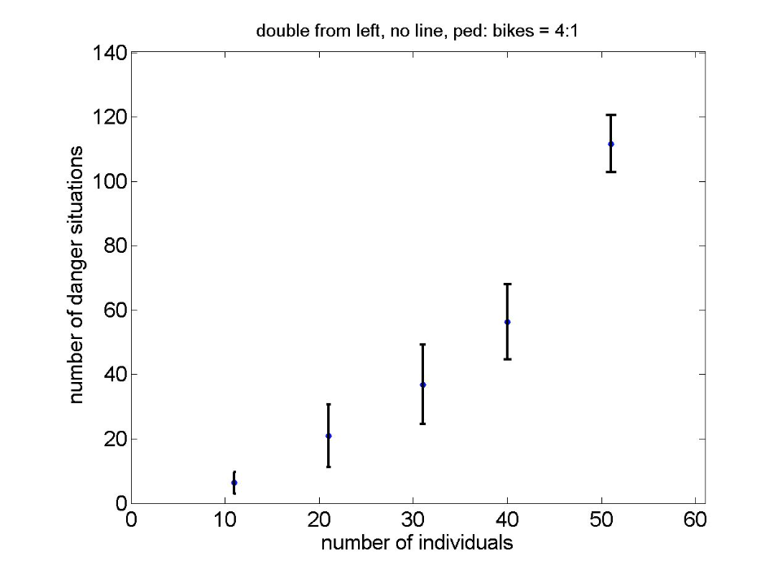
Statistics
no bikeline
112
56
21

Slide 18
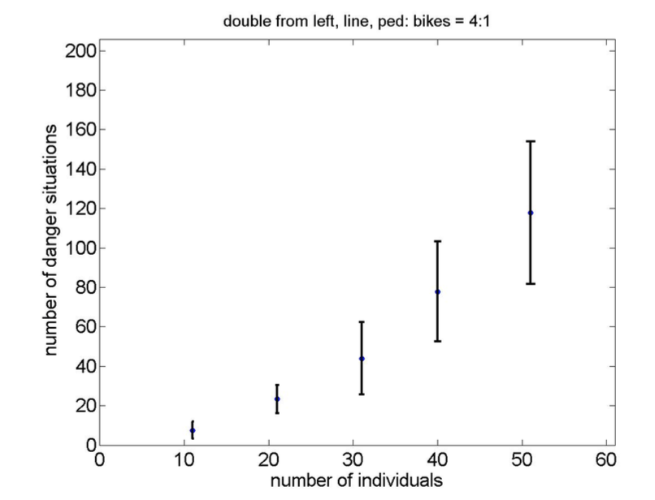
Bikeline
WITH slipstream
118
118
78
78
22
22

Slide 19
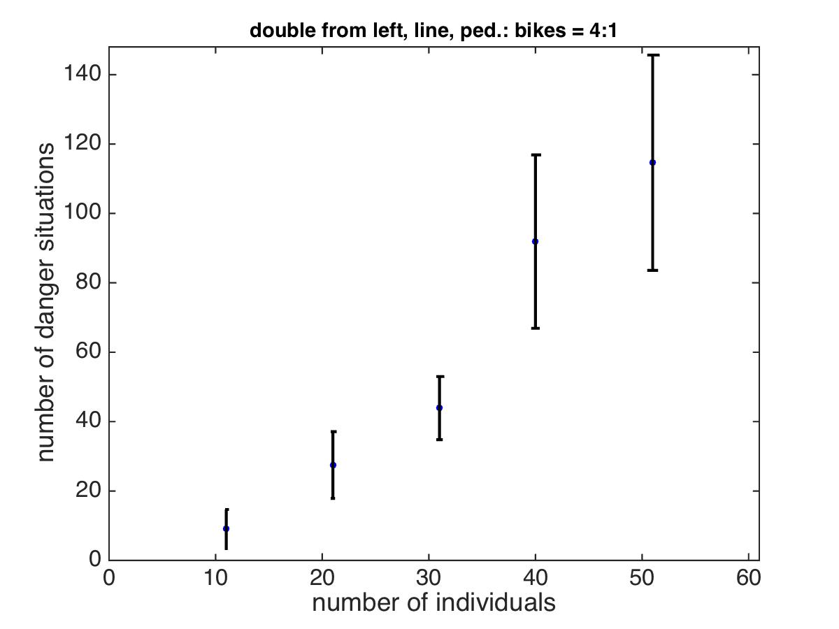
Bikeline
NO slipstream
119
90
26

Slide 20
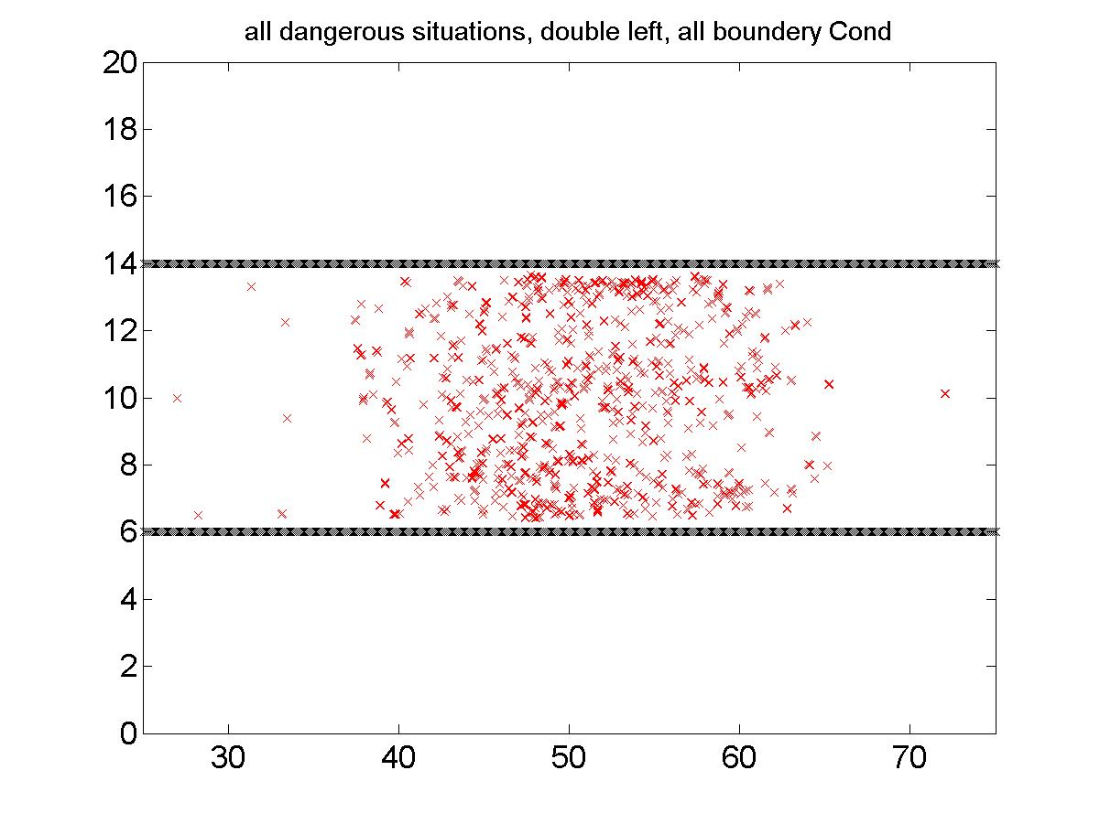
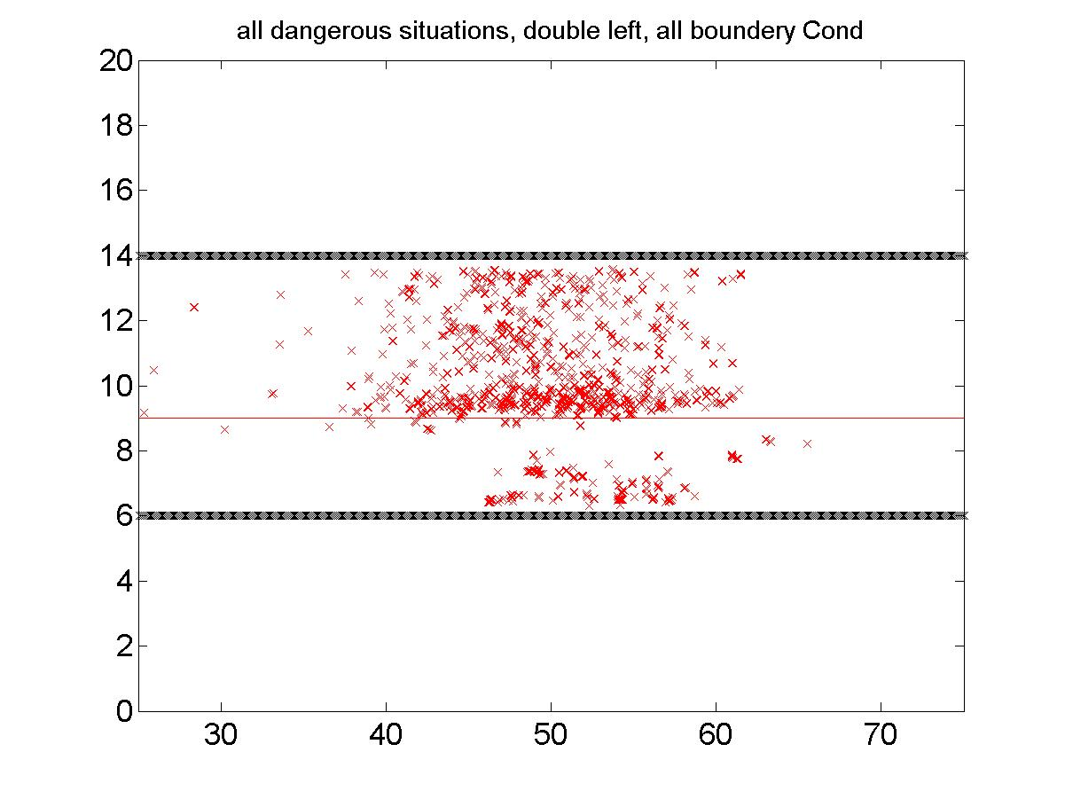

Slide 21
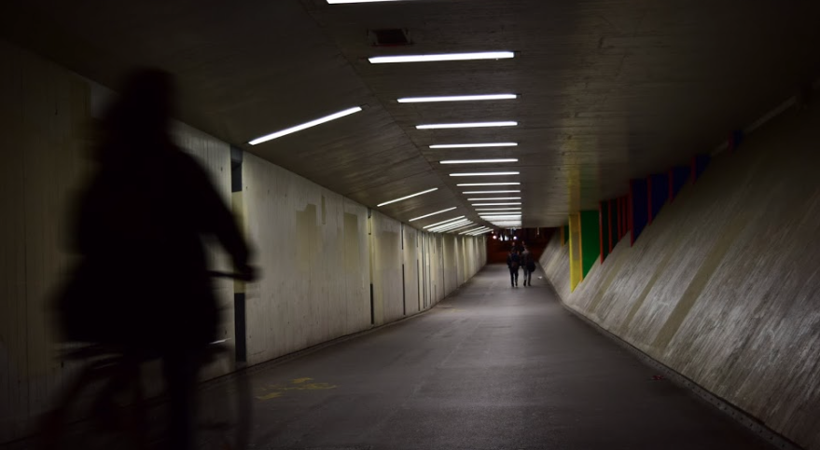

Slide 22
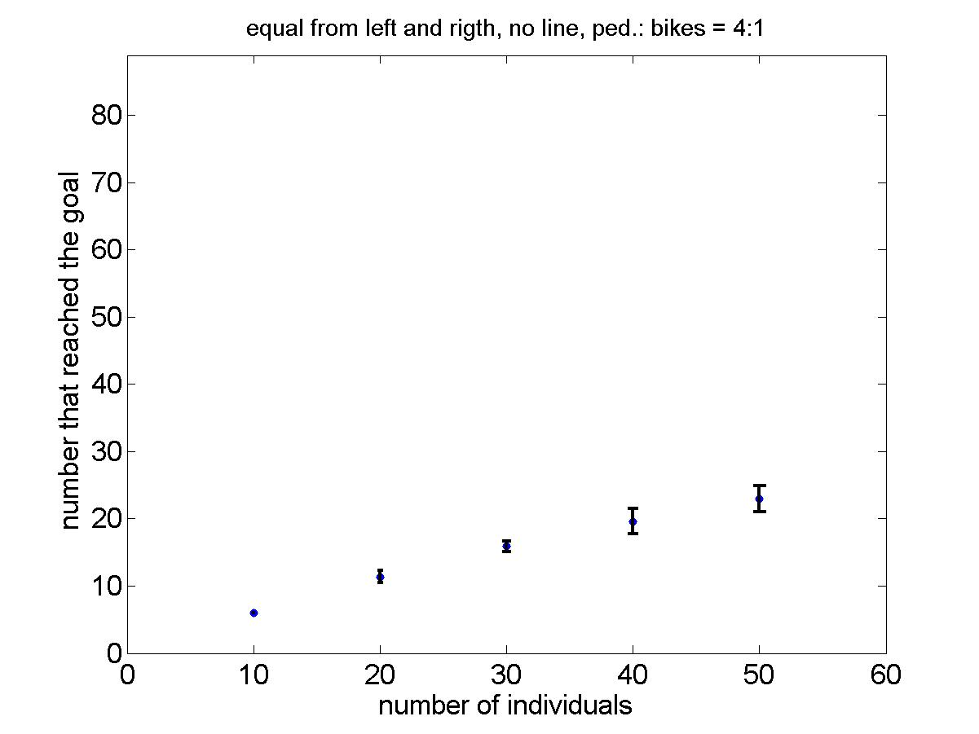
no bikeline
23
19
11

Slide 23
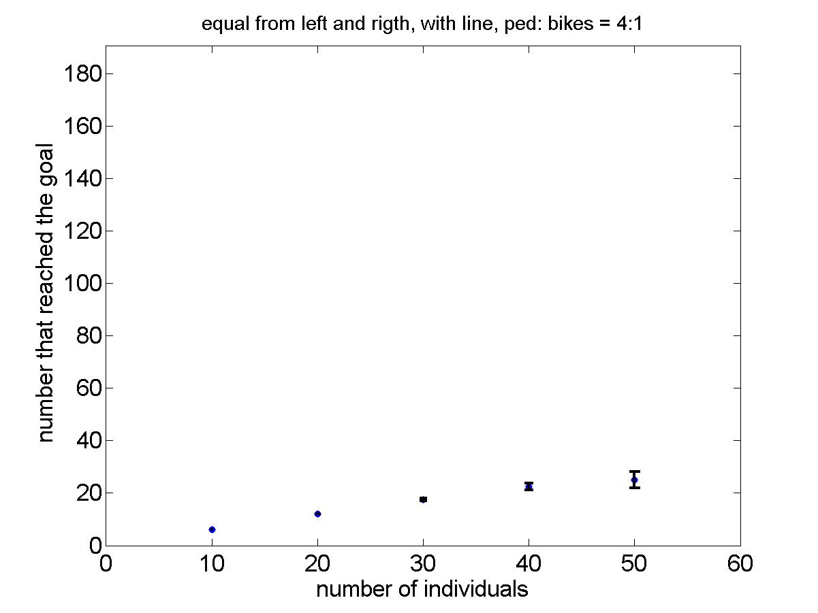
There is a bikeline
25
22
12

Slide 24
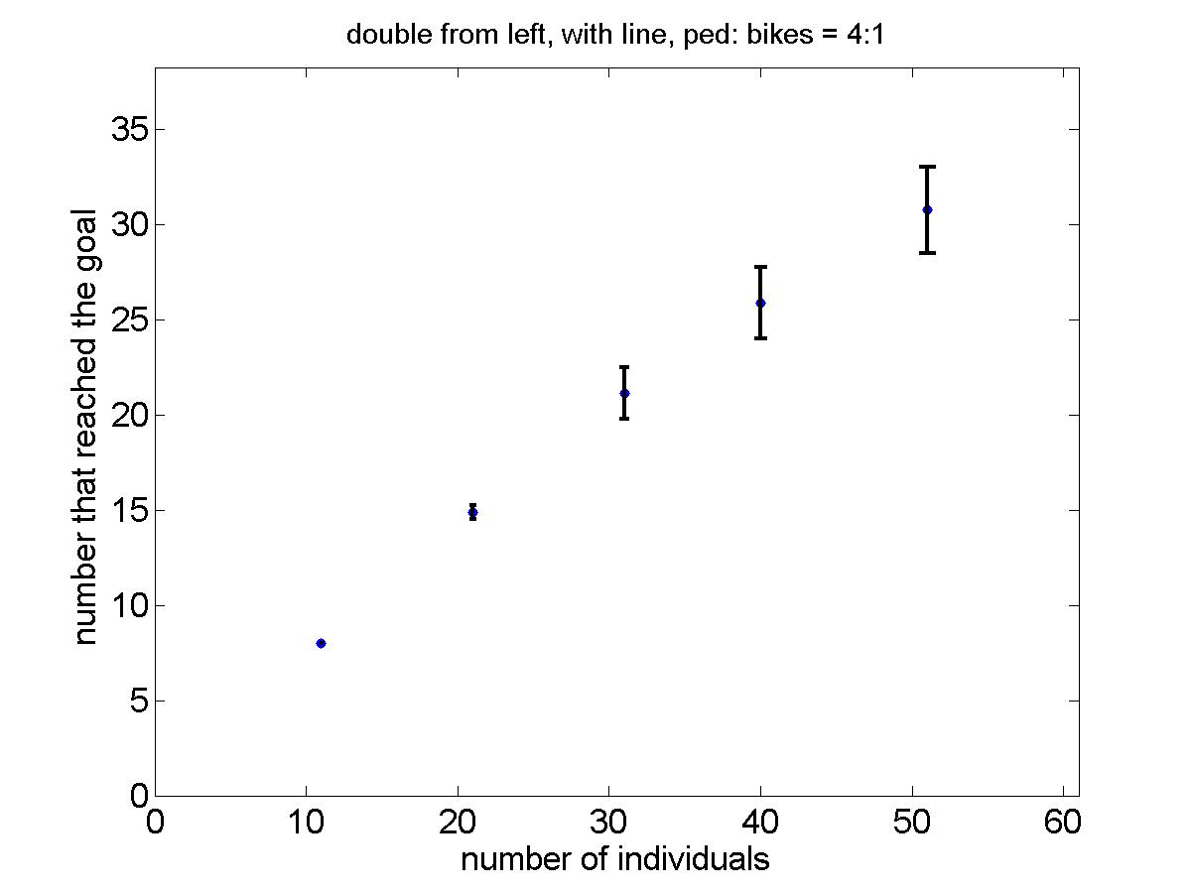
double # ped. & bikes from the left
31

Slide 25
Summary and critical review
Social Force suitable?
Empirical data
Bike lane
Capacity +
Security -
Parameters
Study of papers
Timing
Notes:
Instead of lane separation separation by direction

Slide 26
Thanks!

